Slide 1
Milers

Slide 2
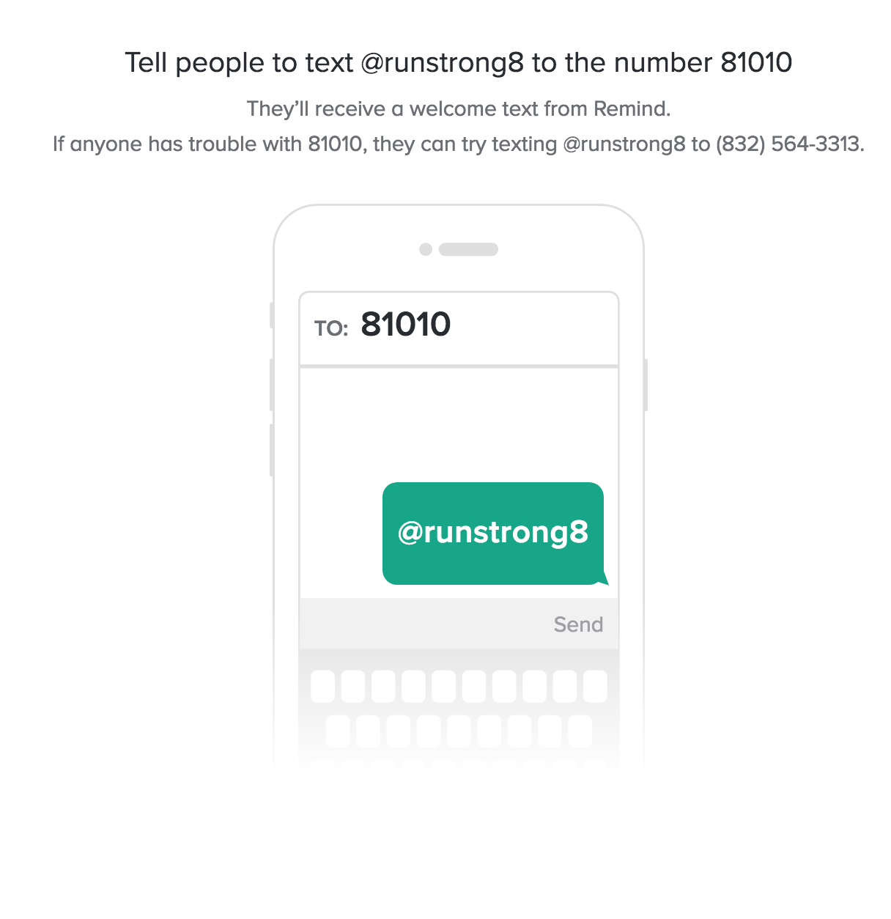
Remind.com
Join this class by using this code:

Slide 3
Student Information Form
https://goo.gl/ksUrWD

Slide 4
Sponsors
Coach England
Mrs. Schueder
Mrs. Rademacher
Mrs. Grill
Mrs. Hall
Mrs. Lunsford

Slide 5
What is Running Club?
We offer running club for grades 1-5
Our purpose is to create a fun environment and have the students develop a lifelong love of exercise, healthy habits and good character traits.
In order to maintain our club each runner will be required to abide by the following policies and Our club sponsors will be helpful by providing tips and tools for all runners to help meet their goals.

Slide 6
Agenda
Running Club will be for 9 weeks in the Fall and 9 weeks in the Spring.
The dates will be listed on the PE website under Running Club.
No matter rain or shine, we will have our meeting.

Slide 7
What to Wear?
Appropriate running attire is required at all meetings.
(PE ATTIRE)
Dress for the weather. We will be outside as much as possible.
We will not be changing clothes afterwards due to the large number of participants. So, plan on wearing what you wear to running club to school that day.

Slide 8
Attendance...
*** Membership in the running club requires a year long commitment which includes regular attendance ***
COMMITMENT
RESPONSIBILITY
DEDICATION
HARD WORK
PUNCTUALITY
All of these character traits are formed because of attendance!

Slide 9
ATTENDANCE COUNTS!
(Commitment & Punctuality)
Doors open at 7:00 am
Doors close at 7:10 am
If you know that your child will be absent, then just send me an email and I will make a note.
If you have more than 3 unexcused absences, then you could be dismissed from the club.

Slide 10
Our Typical Routine…
Arrive at 7:00 AM
Doors will close at 7:10 AM
Warm up and stretch
Run for approximately 20-25 min
Cool down, restroom & water
Line up for dismissal to class or breakfast

Slide 11
Crossing Guard
Please remember that the crossing guard will not be on duty before running club.

Slide 12
DROP OFF PROCEDURES

Slide 13
Breakfast
Students will still be able to eat breakfast after Running Club.
A sponsor will walk them to the cafeteria when dismissed.
Students may NOT eat their breakfast in the gym.

Slide 14
Dismissal From Running Club
Parents, at the 7:50am bell, you must exit the gym doors.
If you would like to re-enter the school, you must sign in at the front office.

Slide 15
BEHAVIOR: (Respect)
This should NOT be an issue!
If it becomes an issue, there will be a phone call to the parent to discuss the situation.
3 marks on behavior could result in dismissal from the club.

Slide 16
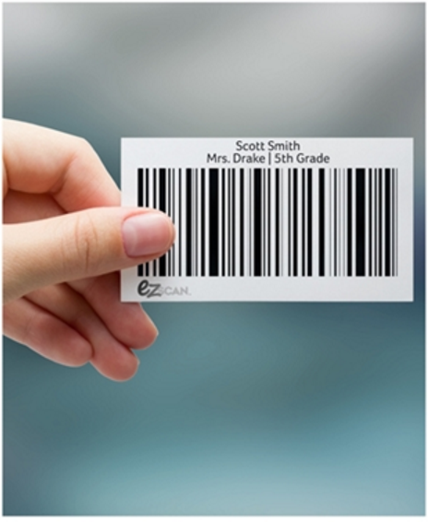
Technology
We will still be using the EZ Scan system.
Each student will get a barcode with a lanyard.
As the students complete a lap, a sponsor will scan their card.
This program automatically counts the students laps.

Slide 19
VOLUNTEER DUTIES:
Help with crowd control/monitor
Spread out along track to monitor
Help escort students into the gym after running
Special events (Thanksgiving Food Drive and last meeting)
Help with assembling lanyards
Attendance Tracker

Slide 20
The Woodlands Marathon Management
The Woodlands Marathon Management, LLC mission is to produce a world-class event while promoting healthy active lifestyles.
They want to make a positive impact in the local community, Houston Region and across the nation through the sport of running.
Students must run 26.2 miles in running club (you can also log outside time with 1K’s, 5K’s, and other outside running.)
Parents email Coach England at the end of each month and give your child’s total miles for outside running.

Slide 21
Milers Shirt
I will be organizing another round of shirt sales.
They will be $15 a shirt.
I will drop the shirt in the Online School Cash items when I know everyone has filled out the student information form.

Slide 22
QUESTIONS?

Slide 23
See you Friday, Sept. 21st at 7:00 AM ………. Ready to run!

